Slide 1


Fresh Job
Theme: Career
Open category
Members:
Izaac Chong
Adrian Foh Wai Mun
Kuah Jia Chen
Hoh Zheng Jie

Slide 2




Competitors

Slide 3
P
R
O
B
L
E
M
S
01
No job hunting website catered for fresh graduates
05
No fixed format for job application forms
02
Lack of feedback from employers
06
Disconnectedness of geographical locations
03
Job listings are not frequently updated
07
Job seeking websites do not support job fairs
04
Tedious job application process
Notes:
No job hunting website catered for fresh graduates
Lack of feedback from employers
Job listings are not frequently updated
Filtering options are not detailed
Tedious job application process
No fixed format for job application hand-in
Disconnectedness of geographical locations
Job seeking websites do not support job fairs

Slide 4
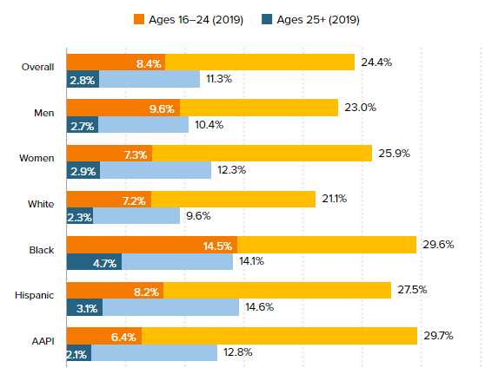
Market Analysis
1. Higher unemployment rates in young adults
Current Market Trends
Source: https://www.epi.org/publication/young-workers-covid-recession/
Notes:
Tripled since COVID-19 pandemic

Slide 5

Market Analysis
2. Employers switching to “new” recruitment processes
Employers are embracing the online recruitment process
Online chat boxes, email applications
Video interviews
Current Market Trends

Slide 6


Solutions
Job search platform for fresh graduates & students
Simplified application process
Connectify
One stop solution for both seekers & hunters
Connectivity with job fairs & industry leaders
Integration with universities
Notes:
A job search platform specifically for fresh graduates and students
Simplified application process
Forum page (insert cool name)
Enable connectivity between job seekers and job fairs/ industry experts (insert cool name)
One-stop solution for both seekers and hunters
Integration of university services

Slide 7
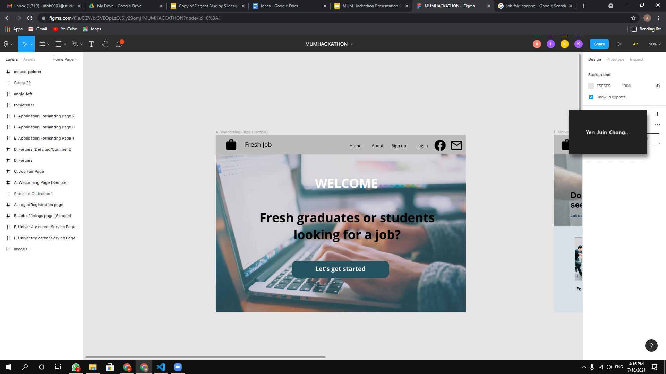
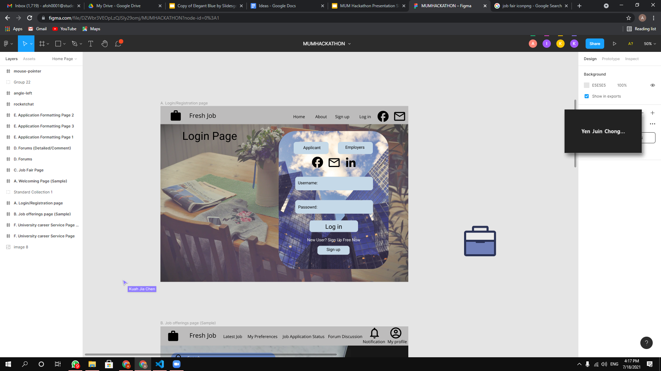
Fresh Job
Welcome Page!

Slide 8


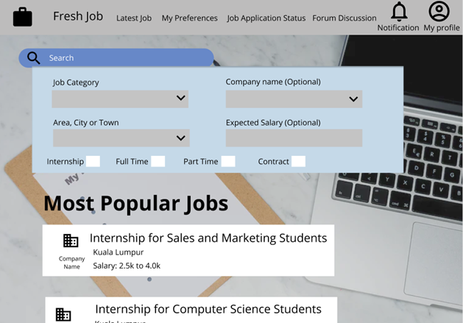



Home Page
Notification button for real-time feedback from employers and new job listings
Popular Jobs are showcased in main page
Menu Ribbon for easy access
Search filter catered for target market

Slide 9

Job Offering Page
Newest and up to date job offerings
Detailed Filtering
Notified when a job offering of their preset preferences is posted
Notification of result

Slide 10

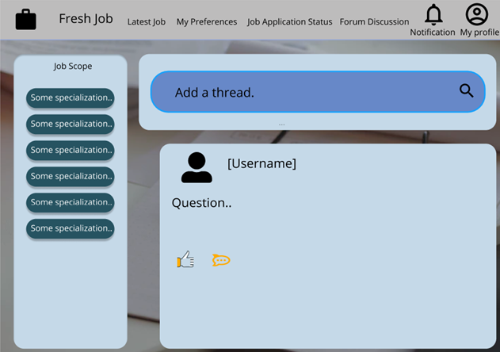
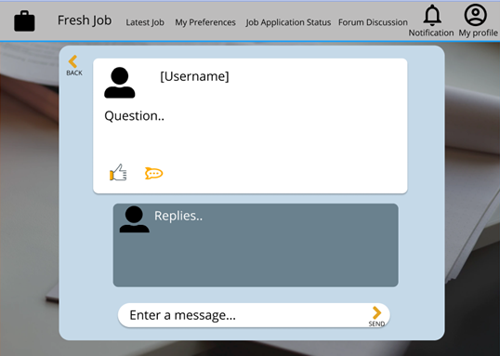
Connectify
Connect with future employers
Learn from other’s experiences
Get guidance from seniors
Talk and gain insights from industry experts

Slide 11
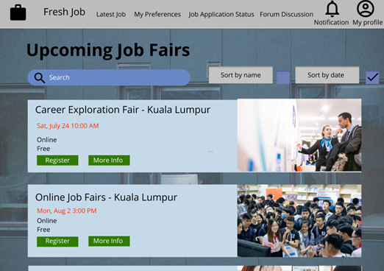
Job Fair Page
Connection to job fairs
Increase the opportunities to meet with experts
Timesaving
Targeted only fresh graduates and students
Notes:
Timesaving - fresh graduates do not have to use huge amount of time to search for the job fairs through online
Targeted only fresh graduates and students - Only those job fairs that targets fresh graduates and students would appears in our app, this helps them to feel convenient when finding a job fair that suit them the most

Slide 12
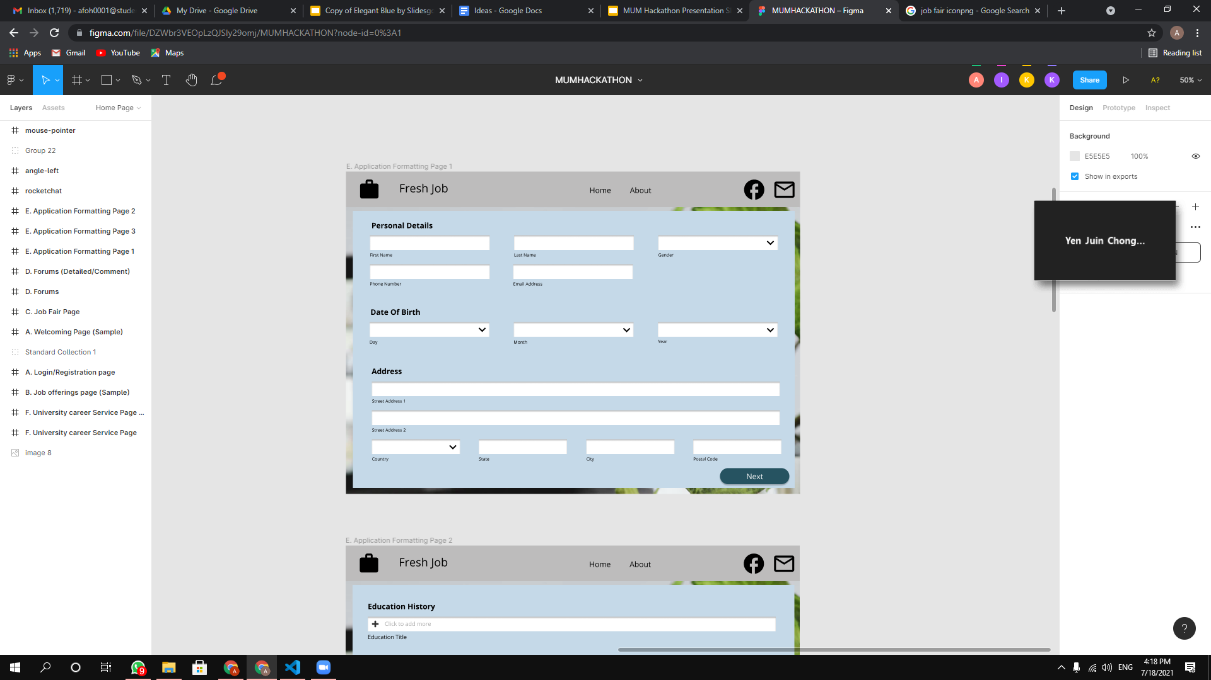
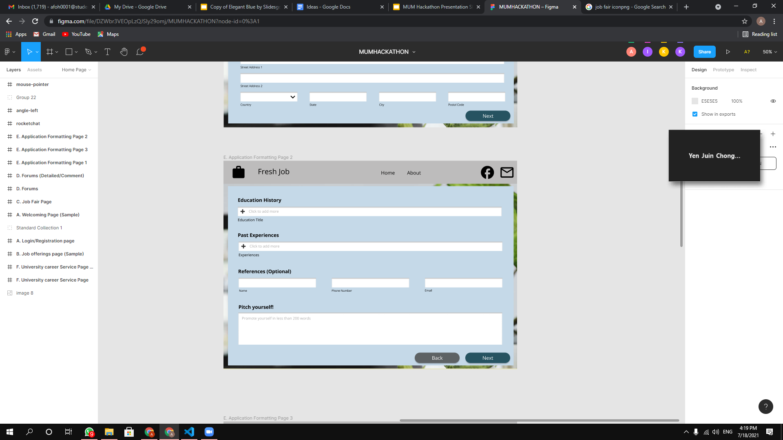
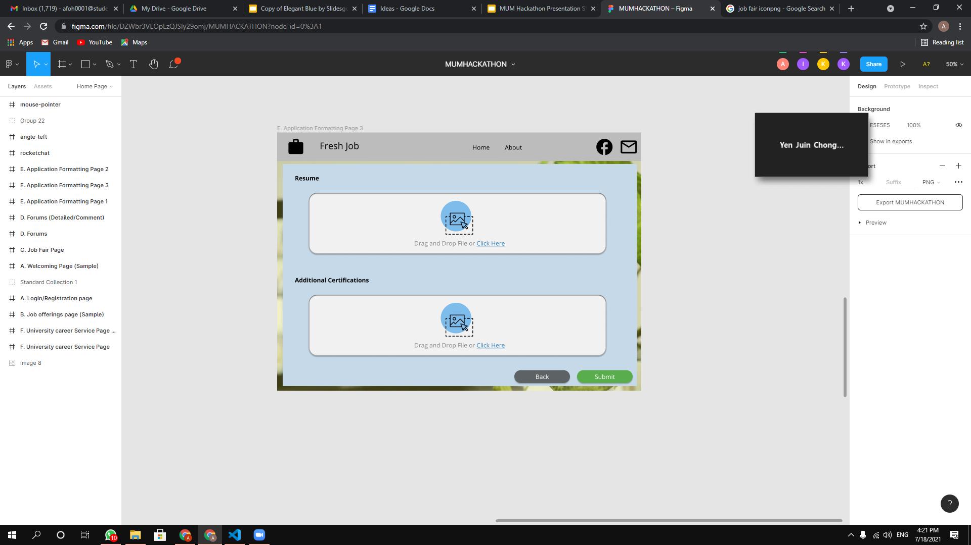
Fixed Format For Applications
Beginner Friendly
Easier for database collection
Less Time Required for Pre-processing
Notes:
The application formatting page is structured and simplified, hence user could easily apply the job without any guidance.

Slide 13
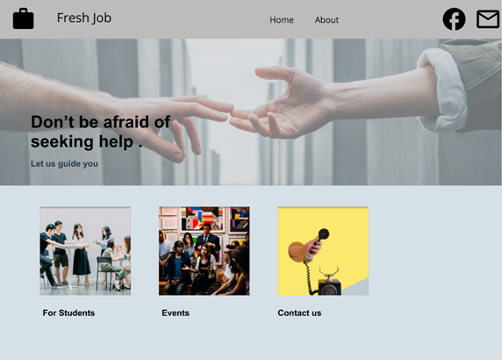
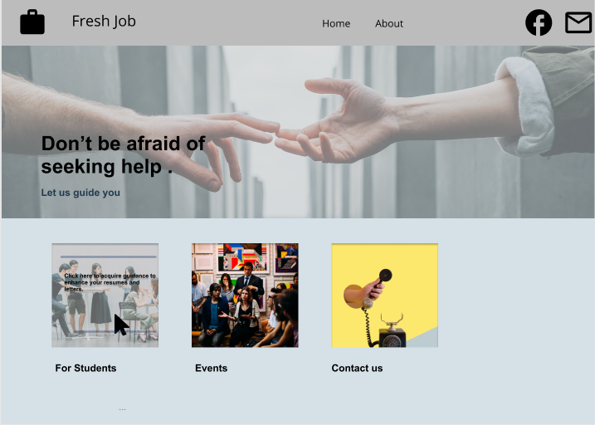
University Service Page
Connect to services provided by universities
Email/ Live Messaging to get help
Immediate help is available
Notes:
Email system / live messaging or video calling to get help - Fresh graduates or students could get help from universities if needed via email or whatsapp ( we are not implementing the API right? )
High accessibility - This page could be easy to access while using our app
Immediate help is available - Once users successfully connected with universities, instant help could be provided by the person in charge.

Slide 14



Why Fresh Job?
Innovation
Uniqueness
Feedback from employers
Notification of result
Connection to job fair
Forum discussion
Target audience is only included fresh graduates and students
Connection between users with alumni or industry experts
Fixed format for job applications

Slide 15
Thank You For Listening

